Slide 1
Wonders of God’s Creation
Donald Ong
Notes:
Greetings and Mother’s Day Tributes.
What an honour!
Tribute to my mother – Raised 7 children successfully – THE MAGIFICENT SEVEN
Tribute to my wife.
Tribute to all mothers for their labour of love and dedication

Slide 2
Wonders of God’s Creation
April May Reflect (ions)
22nd April Ps Ludwig God’s Special People 1 Peter 2:1-10
                Faith and Obedience vs Unbelief and Disobedience
29th April Ps Mei Chin Living Sacrifice, an Act of Worship from our Hearts
                Romans 12:1-2; Proverbs 17:3
                Presenting our bodies as living sacrifice
                Bodies start with hearts
                The Lord tests the hearts
6th May Bro Adrian Align our Vision; Visual Conditions
                Mark 7:14-15; Matthew 15:10-20; 6:22-23
                The lamp of the body is the EYE
                If the EYE is bad (unhealthy), you whole body will be full of darkness
Notes:
Bear with me and allow me to reflect on April and May as a prelude to my message:
Catch the Flow and Frequency of what God has been speaking to us!

Slide 3
Wonders of God’s Creation
April May Reflect (ions)
Flow/Frequency from April and May Messages:
  The importance of control over our eyes
  Lamp of the body (including heart) is the eye
  If the eye is out of focus or blocked, the whole body is full of darkness
  What we see or focus on, will impact the condition of our hearts Matt 6:22-23
  Condition of our heart will result in Faith or Unbelief
  Faith toward God will act out in humble obedience by God’s Grace
  And presenting ourselves as an Act of Worship to God
  The outcome is a destiny fulfilled
  As God’s Special People to proclaim His Praises
Notes:
Our Eyes – the lamp of the body
Impact our Hearts Matt 6:22-23. Note: The context of these verses has to do with our hearts and serving God
Affects our Relationship with God
Our Destiny

Slide 4
Wonders of God’s Creation
Man, the Wonder of God’s Creation
Created in the image of God Genesis 1:27,28
  Full of Great Potential
  Productive “…Be fruitful and multiply;”
  Rule; Subdue and have dominion (i.e Reign) “…Fill the earth and subdue it; have dominion…”
God formed man from dust and breathed breath of life into him. Genesis 2:7
God blessed (spoke into) man Genesis 1:28
Notes:
Last week, we had an amazing Sunday Service.
To me, it was like REALLY????
Let me explain……..
Going with the FLOW…….I am going to talk about Man, the Wonder of God’s Creation

Slide 5
Wonders of God’s Creation
Man, the Wonder of God’s Creation
The Science of Man – How human life is written “God bless (spoke into) them”
DNA - De-oxy-ribo-Nucleic Acid
“determines the structure and function of every cell and is responsible for characteristics being passed from parents to children”
DNA otherwise know as Divine Nature of Abba Father Source: Ps Mei Chin
Life is written in just four letters A – T and G – C
A – Adenine paired to T – Thymine
G – Guanine paired to C – Cytosine
The long sequences of the 4 letters (DNA) form words of instructions or genetic codes

Slide 6
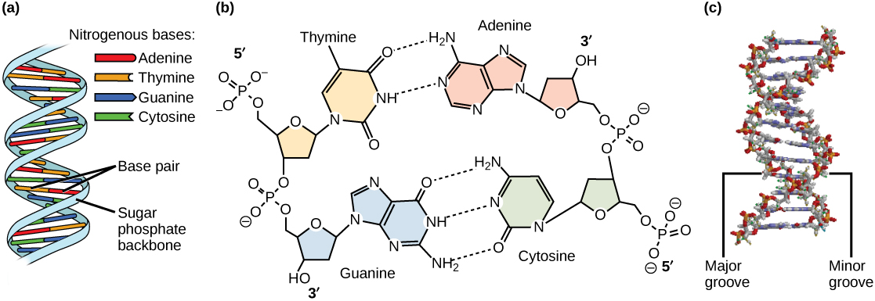
Wonders of God’s Creation
Man, the Wonder of God’s Creation
DNA looks Like
Our DNA is described in long sequences of pairs of A-T and G-C formed in a double helix shape (twisted ladder shape)
DNA communicates the building instructions of cells and living tissues and their correct functions

Slide 7
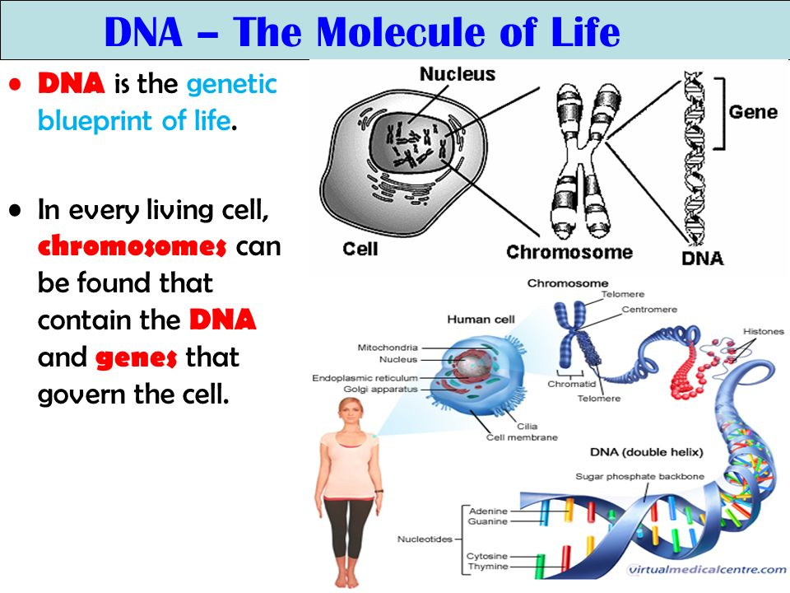
Wonders of God’s Creation
Man, the Wonder of God’s Creation
  Layman’s Explanation
  DNA = Recipe or Blueprint for Living Things

Slide 8
Wonders of God’s Creation
Man, the Wonder of God’s Creation
DNA points to God
DNA in every cell is like a computer program.
A computer program is made up of 1s and 0s (known as binary codes). It may look like this -1010011010001101… and the sequence makes the computer work properly.
DNA in our cell is made up of 4 chemicals abbreviated by letters A,T,G and C. Like a computer program, the arrangement of these letters like CGTGTGACTCGCTCCGAT… instruct the cell action
Amazingly all this written within the tiny space (6 micron) in every cell. This code is >3 billion letters long!
A man has approximately 100,000,000,000,000 (100 trillion) cells.
Computer programs are created by programmers. Logic has been put in them by programmers
DNA points to Creator God because there is intelligence in the codes

Slide 9
Wonders of God’s Creation
Man, the Wonder of God’s Creation
  Interesting scientific details about our DNA
    Each DNA is about 1.8m long
    Fits within a cell nucleus averaging 6 micron
    Our DNA is 99.9% identical, the 0.1% defines all our physical attribute differences, eg. eye, hair, skin color …etc
    Join all our DNA together, the total length is approximately 600 times the distance between Sun and Earth!
  Why am I talking about all these?
    Following from last week
    The God having created the Universe and everything in it, said “It was good”
    The same God after making man, said “It was VERY GOOD!”
    Every person is Special and Precious to God for we are fearfully and wonderfully made. Ps 139:14
    Nobody should feel inferior or unloved and unwanted! It’s devil’s lies
    We are all brothers and sisters!
Notes:
When we look at the night sky and all the wonders of the heavenly bodies, we say “WOW!”
Essentially, when God looked at His creation – man, He said “SUPER WOW!!!”. That was how much we meant to Him.

Slide 10
Wonders of God’s Creation
Man, the Wonder of God’s Creation
  Man was created in God’s image with great potential
  Notwithstanding Man’s potential, under wrong influence, devastation resulted Rom 5:12
    Through one man, sin entered the world “Therefore, just as through one man, sin entered the world,”
    Death through sin “and death through sin,”
    Death spread to all man “and thus death spread to all man, because all sinned-”
    Satan abused man’s potential for his agenda through the one man’s (Adam’s) disobedience
    Started with the eyes! Gen 3:6 “So when the woman saw…..was good…”
  One Man – Jesus, in God’s hands changed our destiny Rom 5:18,19
    One Man’s (Jesus) righteous act v18 “…one Man’s righteous act the free gift came to all men,…”
    One Man’s (Jesus) obedience v19 “one Man’s obedience many will be made righteous.”
  Man’s redeemed potential – Reign in Life through Jesus Christ Rom 5:17
    The “Much More” Love of God “….much more those who receive the abundance of grace and the gift of righteousness”
    Reign in Life “will reign in life through the One, Jesus Christ”
Notes:
The impact ONE MAN can have.
Adam - in Satan’s hands
Jesus Christ – in God’s hands
All of us????

Slide 11
Wonders of God’s Creation
Man, the Wonder of God’s Creation
Recap:
  Man was created in God’s image with great potential
  Man’s potential can be for good or evil
  Man’s redeemed potential is to Reign in Life through Jesus Christ
  For God to use for His Glory when consecrated to Him

Slide 12
Wonders of God’s Creation
Man, the Wonder of God’s Creation
  Brings me to this last slide on Mother’s Day:
  The important role of mothers in their children’s upbringing to realize their potential
  Watch what your children see – the eye is the lamp of the body!
  That potential can be undermined through lack of control over the eyes (supervision?)
  Our redeemed potential is waiting to be fully realized individually continually
  Only in God’s hand when our lives are presented to Him
  Proverbs 31:31 “Give her the fruit of her hands, and let her own works praise her in the gates”
  HAPPY MOTHER’S DAY!!!!

